Slide 1
MODERNO
Moderno –a E-Commerce Website
Naman Garg, Shivendu Khandelwal, Harshit Goyal, Khushi Agarwal
GLA University
Department of Computer Science and Application
28th November 2023

Slide 2
Introduction
We made a e-commerce site named Moderno.
From the comfort of your home to the palm of your hand, our website stands as a testament to technological innovation, ensuring a secure, intuitive, and delightful browsing experience.
Our project aims to address the evolving needs of consumers, leveraging technology to create a dynamic platform that reduces the limitations of traditional commerce.
We guarantee to provide vast product selection,Responsive custumer support,Secure transaction,Fast and reliable shipping and Mobile responsiveness

Slide 3
Objectives
Community Engagement and Reviews: Foster a community by encouraging customer reviews, user-generated content, and social sharing, building trust and credibility for the brand.
Sustainability and Ethical Practices: Source furniture from eco-friendly and ethical suppliers, emphasizing sustainability in materials and manufacturing processes to align with growing consumer demands.
Mobile Optimization: Ensure the website is optimized for mobile devices, considering
the increasing trend of shopping via smartphones and tablets.
Product Diversity and Quality Assurance: Curate a wide array of furniture items spanning different styles, materials, and price ranges while ensuring high-quality standards for all products.

Slide 4
Problem Statement
The furniture retail industry faces many challenges in adapting to evolving consumer preferences and technological advancements. Traditional brick-and-mortar stores struggle to provide an immersive and convenient shopping experience, while existing online furniture platforms often lack personalization and fail to bridge the gap between virtual browsing and real-life expectations. Some of the challenges are lack of visualization of the product and less diversity so we are doing better by providing vast diversity and proper visualization of the project.

Slide 5
Literature Review
Trends in Online Furniture Retail: we analyse and highlight the exponential growth of online furniture retail, indicating a shift in consumer preferences towards the convenience and variety offered by e-commerce platforms.

Slide 6
Methodology
Leveraging insights from these studies, our project aims to integrate innovative visualization technologies, prioritize personalization, and establish a robust logistics system to address the identified challenges in the online furniture retail landscape.
Technologies used are:
Html,Css,Javascript,Tailwind

Slide 7
System Architecture
Frontend Architecture:
User Interface (UI): Presentation layer focusing on the customer-facing aspects, including the website layout, product display, and interactive elements.
Responsive Design: Ensuring adaptability across various devices (desktop, mobile, tablet) for a seamless user experience.
Backend Infrastructure:
Server-side Operations: Handling requests, processing data, managing user sessions, and implementing business logic.

Slide 8
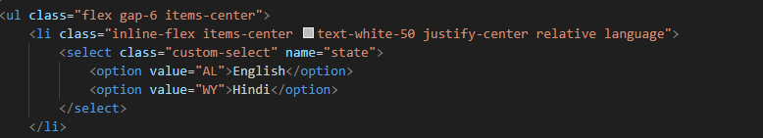
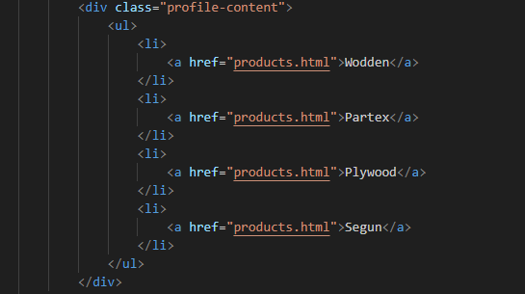
Implementation

Slide 9
Features
User-Friendly Interface:
Intuitive navigation and clean design for easy browsing of furniture categories, styles, and collections.
Sustainability and Eco-Friendly Initiatives: Highlighting eco-friendly products, sustainable sourcing, and ethical manufacturing practices.

Slide 10
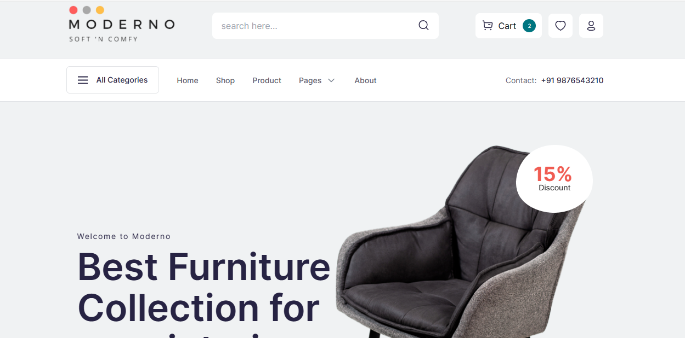
Results
We face some issues in making this site but also we learnt many
things during the development phase and we successfully completed our website with
a beautiful, interactive and responsive layout.

Slide 11
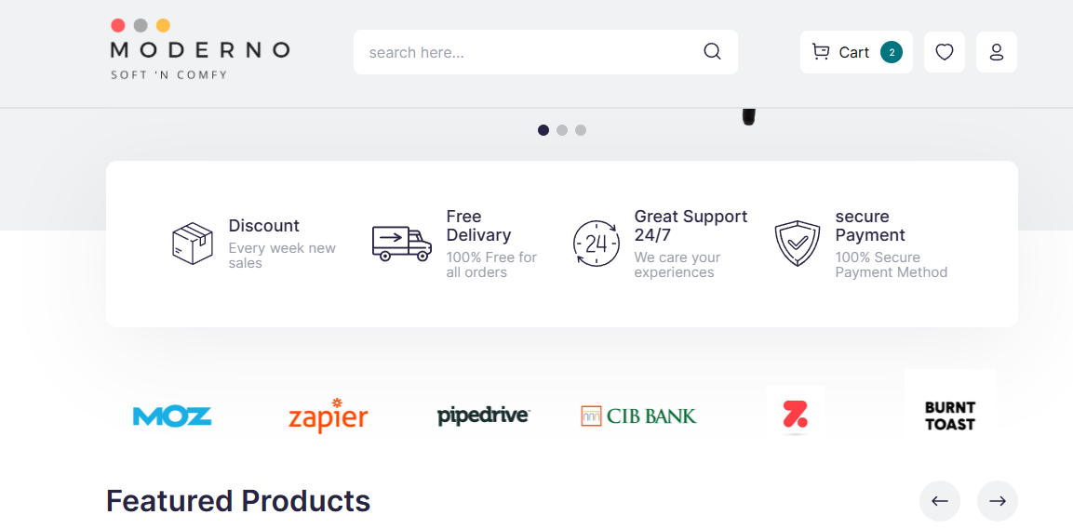

Slide 12
Challenges Faced
We faces a lot of challenge in deciding our project we also faces some challenges in coding and ui/ux part also
But with the help of our respected helpful mentor and our will of not giving up we
have completed the project by learning some new technologies also.

Slide 13
Future Work
According to the future needs we will add make more vast diversity in products gallery.
We try to put 3D visualization of our products to make the customers more satisfied with the shopping.
We will make our whole site on React in future for achieving more functionality.
We will automate the tasks if we get high traffic on the site.

Slide 14
Conclusion
Let us summarize the points we have discussed till now.
We have successfully created our e-commerce site for furniture shopping named Moderno through the skills we possessed.

Slide 15

Acknowledgment
We would like to give special thanks to our respected mentor Mr. Abhishek Kr. Tiwari.
He is such a helpful and co-orperative teacher he helped us a lot throughout our project we can be able to complete our project efficiently under his supervision only.

